Slide 1

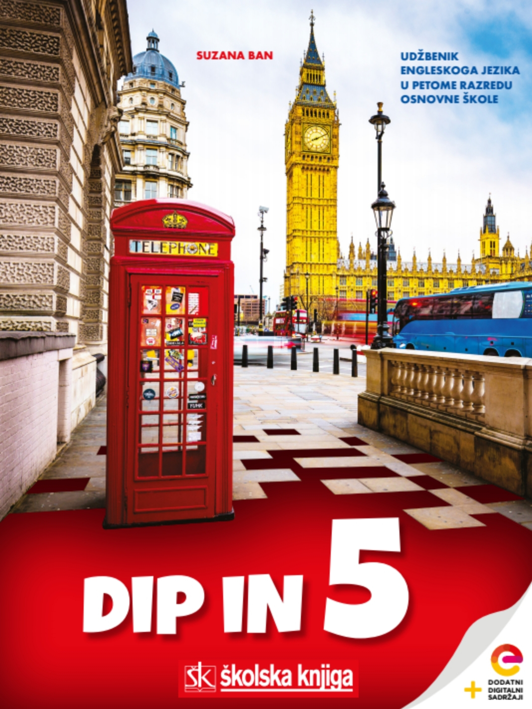
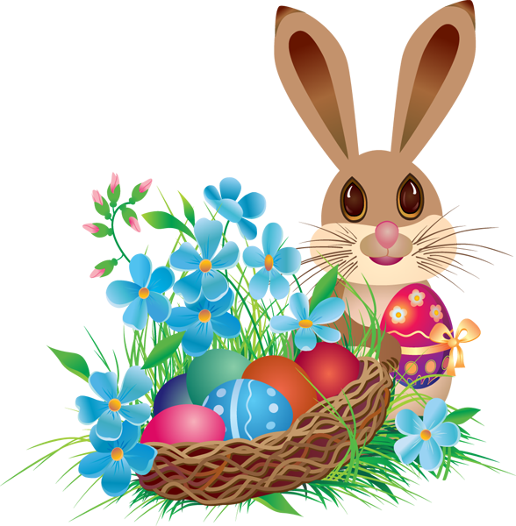

HOLIDAYS;
Easter

Slide 2




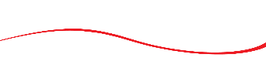
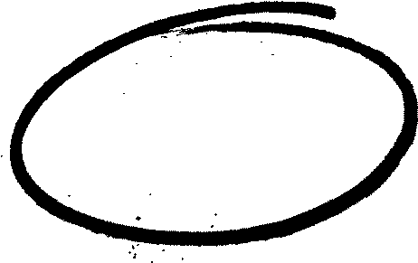
Remember any Easter words you already know! Write them in your notebook or create them here: https://wordart.com/
bunny
chicks
eggs
EASTER

Slide 3
What do you do at Easter?
We dye Easter eggs. Bojimo uskrsne pisanice.
Where do you put them?
In an Easter basket. U uskrsnu košaricu.
What is one of the most popular symbols of Easter?
Easter bunny. Uskršnji zeko.
What happened at Easter?
Jesus Christ resurrected. Uskrsnuo je Isus Krist.
How do we call 40 days before Easter?
Lent. Korizma.
How do we call Sunday before Easter?
Palm Sunday. Cvjetnica.
What is the week before Easter called?
Holy Week. Veliki tjedan.
What is the name of the day on which Christians around the world remember
Jesus' death?
Good Friday. Veliki petak.
Uskrsa is known as EASTER SUNDAY!
Practise here: https://wordwall.net/play/1258/025/771

Slide 4
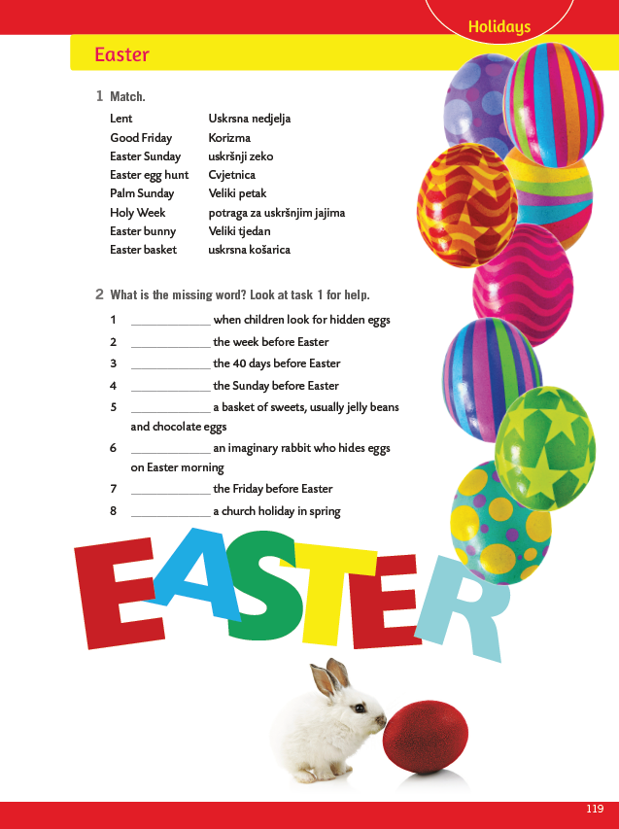
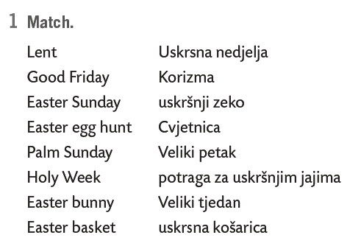
Book, page 119.
1
2
3
4
5
6
7
8
3
Match.
1
7
5
2
4
6
8
Play Easter egg hunt here: https://www.abcya.com/games/easter_egg_hunt

Slide 5

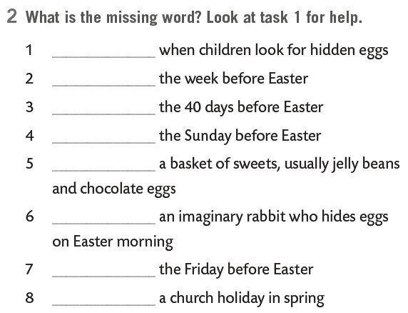
What is the missing word? Look at task 1 for help.
Easter egg hunt
Holy Week
Lent
Practice here: https://wordwall.net/play/13133/996/855
Palm Sunday
Easter basket
Easter bunny
Good Friday
Easter Sunday

Slide 6
Make a digital Easter card using the tool: https://www.canva.com/design/play?category=tACVL2ns1Zw&referrer=ecards-landing-page&utm_source=onboarding

